Slide 1
51st IG meeting
12th September 2019

Slide 2
2.1. Follow-up of infrastructures developments (PCIs, TYNDP, GRIP…)

Slide 3
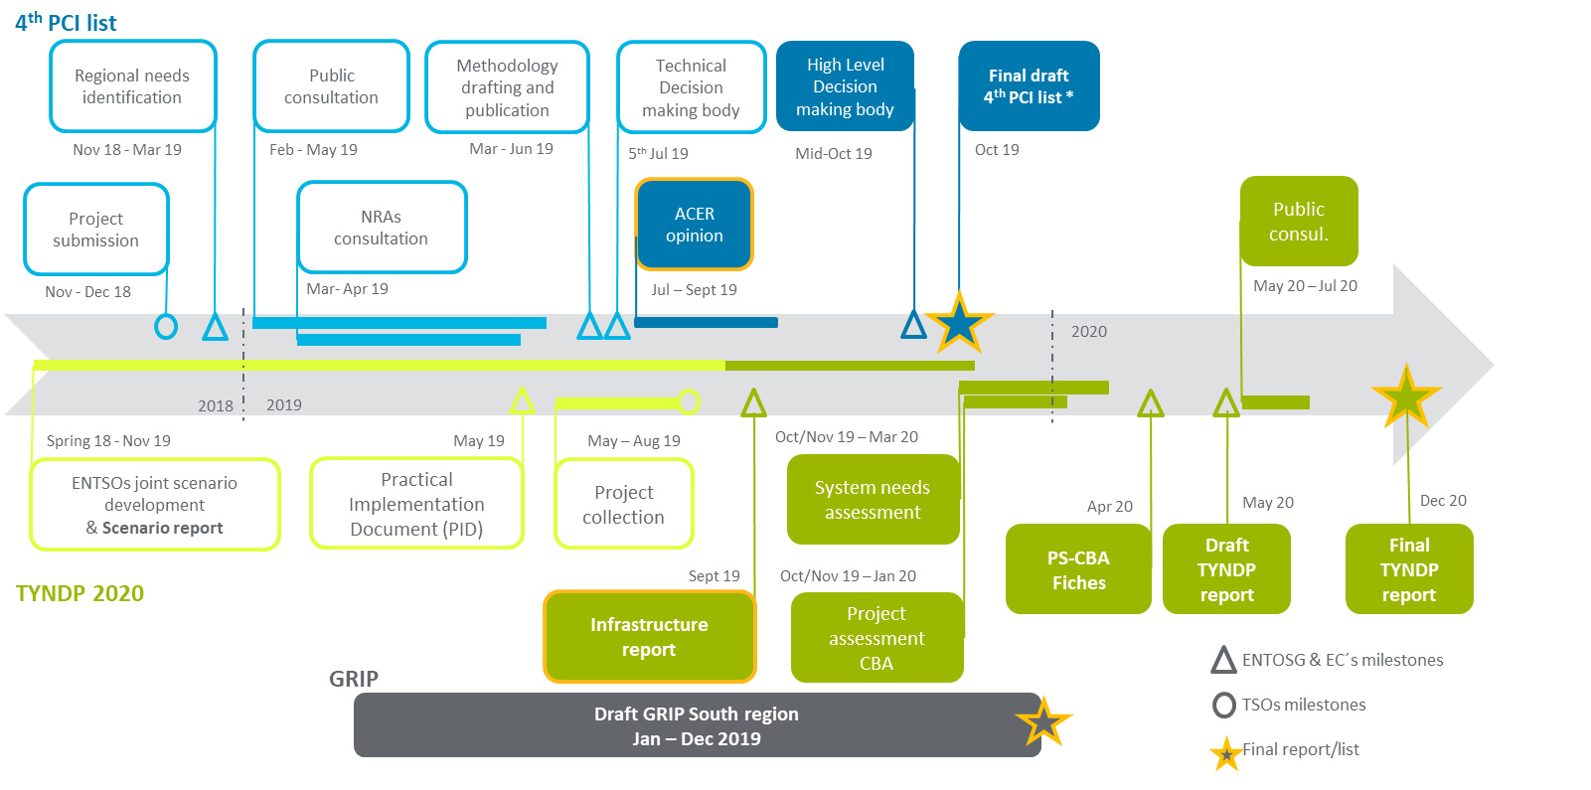
2.1 TYNDP 2020, GRIP & 4th PCI list 2019
*
  * October: the EC adopts the final draft list of approved PCIs via a delegated act procedure

Slide 4
2.1 PCI selection process
For the 4th PCI List, the list of candidates is:
  STEP (France and Spain) was presented by Teréga and Enagás
  3rd Interconnection point (Portugal and Spain), 1st phase was presented by Enagás & REN as candidates
27th June: The final PCI assessment methodology was published by the EC
5th July: The Technical Decision making body presented the draft 4th PCI List
Next steps:
  September – October: ACER´s Opinion on the draft PCI list to be published
  October: the EC adopts the final draft list of approved PCIs via a delegated act procedure
  The list of projects is then submitted by the Commission to the European Parliament and Council

Slide 5
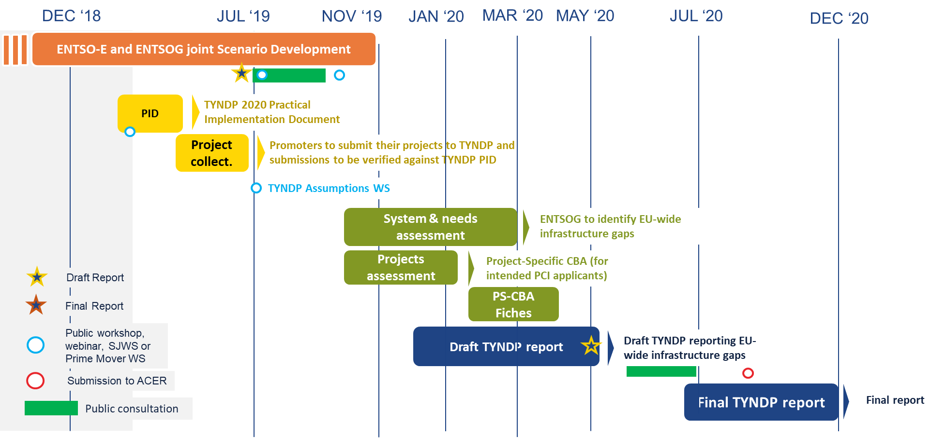
2.1 TYNDP 2020

Slide 6
2.1 GRIP 2019

Slide 7
2.1 GRIP 2019
Feedback from coordinators regarding GRIPs 2019 (last INV-WG meeting on 23th of July):
Common parts
Investment projects
Supply & demand
Modelling
GRIP specific issues
Deeper investigation of investment needs
Barriers to infrastructure investments
Infrastructure resilience & integration: regional N-1 analysis, market demand for new investments, new gas corridors, new investment projects
Gas market development (electricity generation, transport, hubs)
Sustainability (future role of gas)
L-gas

Slide 8
2.1 GRIP 2019
Feedback from coordinators regarding GRIPs 2019 (last INV-WG meeting on 23th of July (continue)):
Way forward / Conclusions
GRIPs as legislative obligation put on TSOs
Transition towards a shortened version of GRIPs that investigate more deeply regional specific issues.
No duplication of topics covered already in TYNDP (e.g. basic overview of projects, supply & demand).
Targeted release of 4th edition of GRIPs by the end of 2019, preferably in line with envisaged evolutions (no TYNDP duplications and focus on regional specific issues)
Involvement of NRAs and stakeholders via the most appropriate regional fora (GRI or other initiatives – to be decided by the involved TSOs)
Publication of the subsequent edition of GRIPs together with the draft TYNDP package

Slide 9
2.2. Report on the use of VIP infrastructures October 16- Sept19: progress and work calendar

Slide 10
2.2. Report on the use of VIP infrastructures October 16- Sept19: progress and work calendar
SEPT 19
OCT 19
NOV 19
DEC 19
JAN 20
FEB 20
MAR 20
1st draft of the report
Completing and checking the 1st draft
Curent status:
Working on the first draft
2nd draft of the report (with Jun19 -Sept19 data)
Intermediate Report (report with Oct16-Jun19 data)
Final Report (report with Oct16-Sept19 data)

Slide 11
3.2 Follow-up gas prices

Slide 12
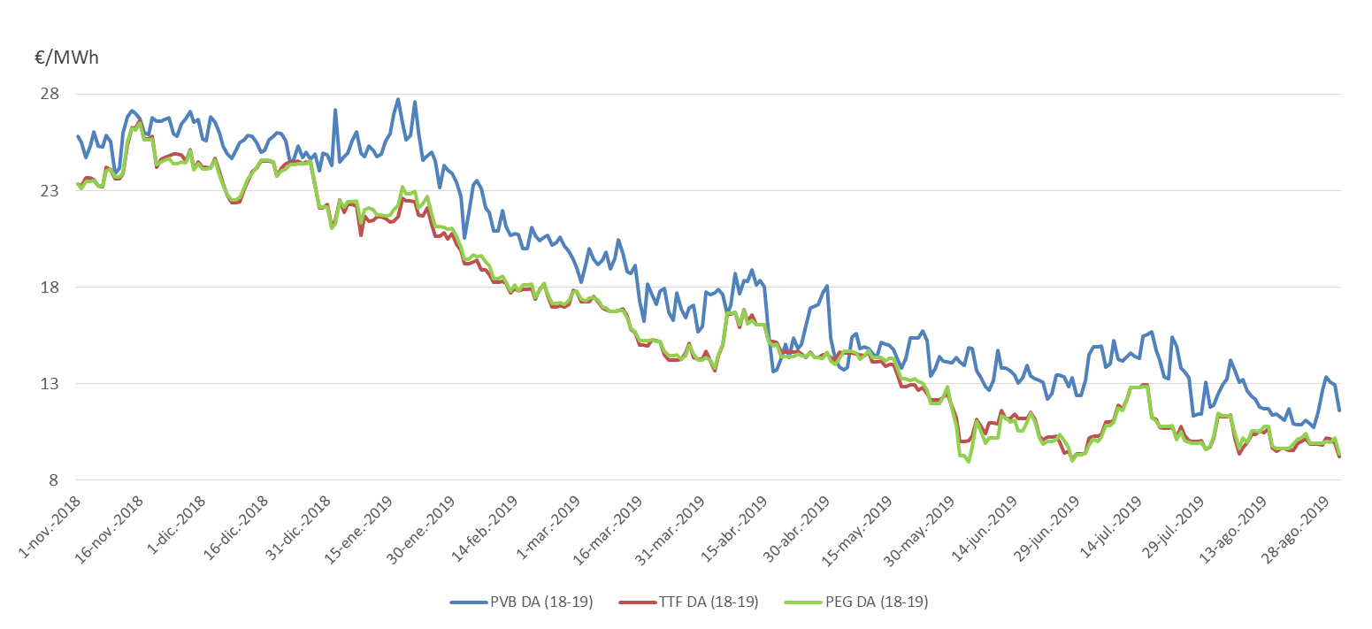
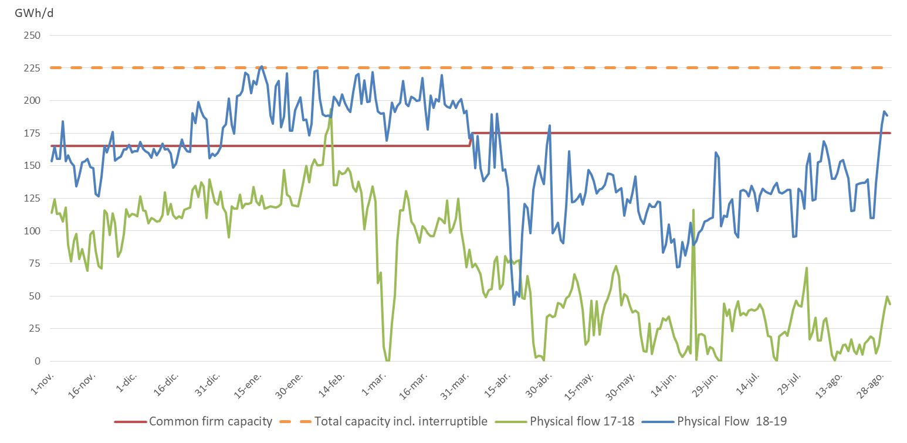
3.2 Follow-up gas prices
Day-ahead prices France, Spain and The Netherlands
Capacity utilization VIP Pirineos 1st Nov – 31st Aug 17-18 vs 18 - 19

Slide 13
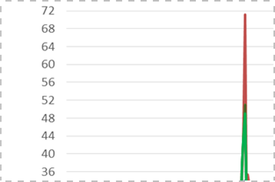
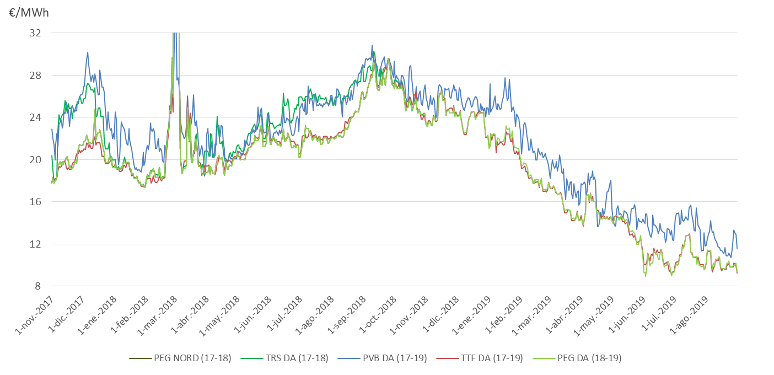
3.2 Follow-up gas prices
Day-ahead prices France, Spain and The Netherlands

Slide 14
3.3. Progress on the implementation of UIOLI LT mechanism in Portugal

Slide 15

3.3 Coordinated application procedure
LT UIOLI
Background
  Annex I to Regulation (EC) No 715/2009 foresees the application of Congestion management procedures in the event of contractual congestion, including Long-Term Use-It-Or-Lose-It mechanism (UIOLI-LT)
  The Regulation (EU) 2017/459(new NC CAM) introduced the obligation to offer Long-term capacities at interconnection points. The offer of Long-term capacity at VIP Ibérico started with the 2018/2019 Annual yearly capacity auction at 2 July 2018 (for 5 year)
  The SGRI WP 2019-2020 foresees the Implementation of UIOLI LT mechanism at VIP Iberico as a deliverable regarding Target 2. Market Integration In The Region
  At the 50th IG Meeting, last 17th June, REN commited with the task to implement the Portuguese mechanism, in a coordinated way with Enagás and in such a way that can contribute to a harmonized UIOLI LT mechanism at the SGRI area

Slide 16


3.3 Coordinated application procedure
LT UIOLI
Operator will check in April of each year, the utilization rate of the contracts of those users that have booked capacity for more than one year and with contracts in force for the next gas year (yearly basis or longer).
TSO´s shall analyze the utilization rate of those contracts with a duration equal to or longer than one year that were in force in the two periods between April 1 and September 30 of the previous year, and between October 1 of the previous year and March 31 of the current year. In the event that that there were 4 consecutive quarterly contracts, those contracts will also be subject to analysis.
The utilization rate:
Systematically underutilization: if at least one of the following conditions is met:
  In the two periods, the utilization rate results below 80%, or
  In the two periods, there are at least 60 days in which the user nominates beyond 80% of the booked capacity and re-nominates less or half of the initially nominated.
If infrautilization is detected, the TSO will check if the user has offered this capacity on the secondary Market at a reasonable price. If yes, the capacity won´t be withdrawn.
So that the TSO can verify that the shipper has done everything possible to release that capacity, the underutilized capacity must be offered in PRISMA unless he can prove that all this capacity has been reallocated.
To be confirmed by the regulators
  $$Utilization rate= \frac{Utilized daily capacity average}{Booked capacity average}x100$$
To be confirmed by the regulators
To be confirmed by the regulators

Slide 17
3.3 Coordinated application procedure
LT UIOLI
To be confirmed by the regulators
The NRA will decide before June 1th whether or not to withdraw underutilized capacity.
The capacity will be withdrawn from the yearly contracts (or longer) that the shipper had in force at the time of the analysis and will be offered firstly in the Quaterly auctions and then in Monthly auctions.
Such capacity cannot be offered at secondary market:
  15 days prior to quarterly auctions and until the respective results are published
  10 days prior to monthly auctions and until the respective results are published
The % of capacity to be withdrawn will be calculated as follows:
𝐶𝑎𝑝𝑎𝑐𝑖𝑡𝑦 𝑡𝑜 𝑏𝑒 𝑤𝑖𝑡ℎ𝑑𝑟𝑎𝑤𝑛=100% −𝑀𝐴𝑋(1^𝑠𝑡 𝑝𝑒𝑟𝑖𝑜𝑑 𝑢𝑡𝑖𝑙𝑖𝑧𝑎𝑡𝑖𝑜𝑛;2𝑛𝑑 𝑝𝑒𝑟𝑖𝑜𝑑 𝑢𝑡𝑖𝑙𝑖𝑧𝑎𝑡𝑖𝑜𝑛)
Once the resolution by the NRA has been issued and before June 10th, TSO´s will inform the network users of the capacity to be withdrawn.
original network users shall:
  pay the diferences of price between the original auction and the reallocation auction
  keep the capacities not realocated, including its rights of utilization and payment obligations
To be confirmed by the regulators
To be confirmed by the regulators

Slide 18
4. WP Third target. Contribution of gases to decarbonisation

Slide 19





4.1. Follow-up - Projects
  Power to Green Hydrogen Mallorca
  RenovaGas
  SUN2HY (Sun to Hydrogen)
  Energy solutions
  Demonstrative facility in Zaragoza for standardised quality and flow rate measurements for hydrogen
  FenHYx
  Standardised quality measurements for European biomethane (RICE)
  Innovation in renewable gases
  Jupiter 1000
  Energy efficiency R&D
  New solutions for biomethane and future projects such as Power to Gas

Slide 20

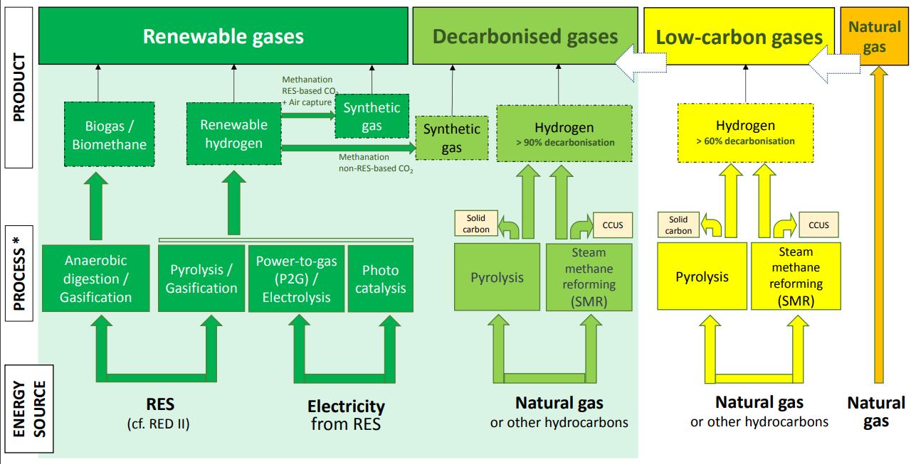
4.1. Follow-up – Gas organisation initiatives
Align gas terminology

Slide 21
Thank you for your attention!

