Slide 1
Cross-Regional Roadmap for Intraday
DRAFT
Updated
31/10/2011

Slide 2
Background
The target model is a continuous implicit allocation with capacity pricing reflecting congestion by 2014
Purpose of cross-regional roadmap:
to identify key milestones and accountabilities at EU and regional level
as a tool to communicate European and regional priorities
to increase consistency across the regions and pave the way for the completion of the Internal Electricity Market by 2014
The cross-regional roadmap is based on:
regional consultation and contribution to the European energy work plan;
Input from AESAG;
Stakeholder comments to earlier drafts;
Discussion at ACER coordination group for ERI;
FG on CACM.

Slide 3
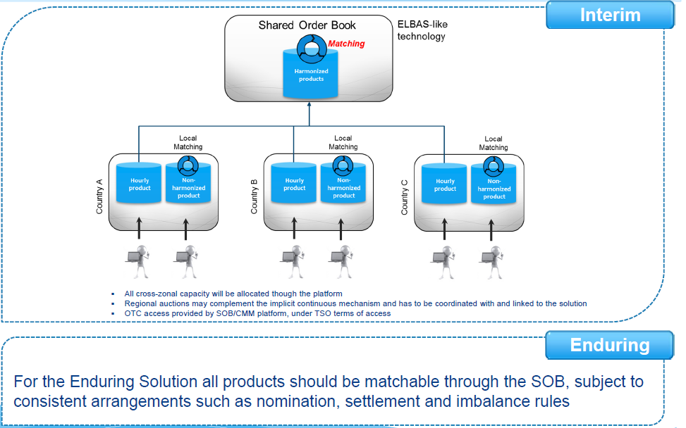
Intraday cross border trade: Interim model 2012
ENTSO-E and Europex propose to implement an “ELBAS-like” solution for the Shared Order Book (SOB) and Capacity Management Module (CMM), with hub-to-hub shipping for standard hourly products and coordinated capacity determination
Governance framework: Interim solution to be kept simple to avoid delay and reflecting simplicity of the interim solution
Note:
Implicit auctions may remain (nationally / regionally) if sufficient liquidity and adequate gate closures
Explicit access allowed on some borders for OTC and TSO balancing actions because, for example, domestic gate closure times are different.

Slide 4
Intraday cross border trade: target model 2014
As agreed in the Capacity Allocation and Congestion Management (CACM) Framework Guideline
The CACM target model will be elaborated in more detail in the ENTSO-E network code on intraday and the proposed Governance Guideline
Implicit auctions may remain (nationally/regionally) if sufficient liquidity and adequate gate closures
All cross-zonal capacity allocated through the pan-European platform
SOB and CMM, plus an evolution of continuous implicit trading, featuring:
reliable capacity pricing reflecting congestion
automatic matching
appropriate block bids and sophisticated products
Note:
should avoid discrimination between products
OTC trading removed following market consultation and regulatory approval
Harmonised closing time for ID trades (avoid overlapping with balancing)

Slide 5
The Intraday Implementation Project
The intraday project was initiated by NWE TSOs to implement the European target model in NWE region
The 20th Florence Forum supported the NWE project to establish a intraday market by the end of 2012
The Forum urged the NWE project participants to actively coordinate with stakeholders from other regions
NWE project extended to other borders ready to implement the interim solution (subject to consultation with relevant parties)
The interim intraday solution will go-live by the end of 2012

Slide 6
Expected benefits
Interim model in 2012
Market parties able to trade on a continuous basis between participating Member States
Real time energy transactions between Finland and France
Enduring model in 2014
Implemented on a European wide basis and included additional features
Reliable capacity pricing reflecting congestion (i.e. in case of scarce capacity)
Sophisticated products to meet market participants needs

Slide 7
Intraday Implementation: initial timeline
Tasks | Deadline | Responsibility
INTERIM SOLUTION
Complete TSO/PX MoU | December 2011 | TSOs and PXs
Develop PX core arrangements* | June 2012 | PXs
Develop TSO core arrangements | June 2012 | TSOs
Local implementation on border-by-border basis | During 2012 | TSOs and PXs
Go live of interim solution | End of 2012
TARGET MODEL
Develop Governance arrangements | Ongoing | NRAs, TSOs & PXs
Develop and consult on options for intraday capacity recalculation and pricing | During 2013 | PXs and TSOs
Develop and consult on options and specifications for sophisticated products | During 2013 | PXs and TSOs
Implementation of intraday capacity recalculation | Mid 2014 | TSOs
Implementation of sophisticated products | End 2014 | PXs
Implementation of pricing of capacity | End 2014 | TSOs and PXs
Go live of Target Model / enduring solution | End of 2014
* Features of the interim “Elbas-like” solution shall be discussed in a stakeholder workshop in Q4 2011

Slide 8
Project / region | 2011 |  | 2012 |  |  |  | 2013 |  |  |  | 2014
 | Q3 | Q4 | Q1 | Q2 | Q3 | Q4 | Q1 | Q2 | Q3 | Q4 | Q1 | Q2 | Q3 | Q4
NWE project |  |  |  |  |  | * |  |  |  |  |  |  | ** | √
CWE region |  |  | 1 |  |  | √
Northern region |  |  | 1 |  |  | √
FUI region |  |  |  |  | 2 | 3 √
CS region |  |  |  | 4 |  | 5
SW region |  |  |  |  |  | √
CE region |  | 6 |  |  | 7 | 8 |  |  |  | √
Baltic region |  |  |  |  |  |  |  |  |  | √ | …
SE Region |  |  |  |  |  |  |  |  |  |  |  |  | … | √
CACM FG target model implementation |  |  |  |  |  |  |  |  |  |  |  |  |  | √
Key:
* - NWE intraday 1 step; ** - NWE intraday 2 step; √ - implicit intraday solution; … - unclear whether would join NWE

Slide 9
Milestone | Action
1 | Implement intraday solution on NorNed
2 | Implement intraday trading on SEM-GB interconnector
3 | Develop options for extending the NWE solution to SEM (FUI GB-SEM border)
4 | Implement explicit intraday allocation on all borders
5 | Finalise regulators’ position on intraday and develop regional roadmap
6 | Improve existing intraday allocation mechanism on CE borders
7 | Propose options to implement an intraday solution in line with the intraday target model and NWE developments
8 | Evaluate options and propose a solution to implement intraday solution in line with intraday target model in 2013

Slide 10
CWE region
Project milestones | 2011 |  | 2012 |  |  |  | 2013 |  |  |  | 2014
 | Q3 | Q4 | Q1 | Q2 | Q3 | Q4 | Q1 | Q2 | Q3 | Q4 | Q1 | Q2 | Q3 | Q4
CWE region |  |  | 1 |  |  | √
Regional actions
Mechanisms for implicit allocation of intraday capacity were launched on the France-German border in December 2010 and the Belgian-Netherlands border in February 2011
A project has been established to implement intraday trading on the NordNed interconnector in Q1 2012
CWE countries are active members of the NWE intraday project to introduce an implicit intraday solution by the end of 2012 and implement the intraday target model by 2014

Slide 11
Northern region
Project milestones | 2011 |  | 2012 |  |  |  | 2013 |  |  |  | 2014
 | Q3 | Q4 | Q1 | Q2 | Q3 | Q4 | Q1 | Q2 | Q3 | Q4 | Q1 | Q2 | Q3 | Q4
Northern region |  |  | 1 |  |  | √
Regional actions
The Nordic intraday trading solution (ELBAS) facilitates continuous trading and is an integrated system with effectively a one-to-one relationship between CMM and SOBF
Projects have been established to implement intraday trading on the NorNed interconnector in Q1 2012, on SwePol Link in Q4 2011, and to extend ELBAS to the Baltic region in 2013
Northern region countries are active members of the NWE intraday project to introduce an implicit intraday solution by the end of 2012 and implement the intraday target model by 2014

Slide 12
FUI region
Project milestones | 2011 |  | 2012 |  |  |  | 2013 |  |  |  | 2014
 | Q3 | Q4 | Q1 | Q2 | Q3 | Q4 | Q1 | Q2 | Q3 | Q4 | Q1 | Q2 | Q3 | Q4
FUI region: GB-CWE border |  |  |  |  |  | √
FUI region: GB-SEM border |  |  |  | 2 |  | 3
Regional actions
The FUI region is an active member of the NWE intraday project to introduce an implicit intraday solution by the end of 2012 and implement the intraday target model by 2014
The SEM market may face challenges implementing a purely continuous approach. Options for incorporating SEM into the NWE project to implement the intraday target model will be explored in Q4 2012.
SEM may (as part of FUI) provide for transitional arrangements for intraday which are defined in section 1.2 of CACM

Slide 13
CS region
Project milestones | 2011 |  | 2012 |  |  |  | 2013 |  |  |  | 2014
 | Q3 | Q4 | Q1 | Q2 | Q3 | Q4 | Q1 | Q2 | Q3 | Q4 | Q1 | Q2 | Q3 | Q4
CS region |  |  |  | 4 |  | 5 | …
Regional actions
A project has been established to implement an interim explicit allocation process on all CS region borders in Q2 2012
CS region will propose a roadmap to implement the intraday target model, which takes into consideration the NWE pilot project, in Q2 2012
After checking coherence of the propose roadmap with existing intraday projects, the roadmap will be submitted for consultation in Q4 2012
After the consultation is closed, the NRAs will decide on and commit to the necessary steps to implement the intraday target model

Slide 14
SW region
Project milestones | 2011 |  | 2012 |  |  |  | 2013 |  |  |  | 2014
 | Q3 | Q4 | Q1 | Q2 | Q3 | Q4 | Q1 | Q2 | Q3 | Q4 | Q1 | Q2 | Q3 | Q4
SW region |  |  |  |  |  | √
Regional actions
The SW region explored how to implement the intraday target model in Q1 2011
A consultation with the Stakeholder Group was held in Q3 2011. Implementation Group to undertake a feasibility study and simulation
In Q1 2012, the necessary systems and regulatory changes to implement continuous trading by Q4 2012 will be identified
SW TSOs and PXs will get involved in the development of the CMM and SOB in Q1 2012.
Implicit auctions could be retained as a second layer in MIBEL.

Slide 15
CE region
Project milestones | 2011 |  | 2012 |  |  |  | 2013 |  |  |  | 2014
 | Q3 | Q4 | Q1 | Q2 | Q3 | Q4 | Q1 | Q2 | Q3 | Q4 | Q1 | Q2 | Q3 | Q4
CE region |  | 6 |  | 7 | 8 |  |  |  |  | √
Regional actions
Improve existing intraday allocation mechanism on CE borders in Q4 2011
A stepwise approach to implementing the intraday target model, will be proposed in Q2 2012
The options for implementing the intraday target model will be evaluated by regulators and a solution decided upon in Q3 2012
Establishing local intraday markets (only DE, CZ and PL local intraday markets organized by PXs are in operation)

Slide 16
Baltic region
Project milestones | 2011 |  | 2012 |  |  |  | 2013 |  |  |  | 2014
 | Q3 | Q4 | Q1 | Q2 | Q3 | Q4 | Q1 | Q2 | Q3 | Q4 | Q1 | Q2 | Q3 | Q4
Baltic region |  |  |  |  |  |  |  |  |  | √
Regional actions
- Implementation of intraday trading based on the ELBAS is planned for 2013

Slide 17
Integration of SEE Region
Project milestones | 2011 |  | 2012 |  |  |  | 2013 |  |  |  | 2014
 | Q3 | Q4 | Q1 | Q2 | Q3 | Q4 | Q1 | Q2 | Q3 | Q4 | Q1 | Q2 | Q3 | Q4
SEE Region |  |  |  |  |  |  |  |  |  |  |  |  | … | √
Regional actions
Implement a step-wise approach with sub-regional implementation of cross-border intraday trading mechanisms and a pan-regional approach to implementing the intraday target model
Romania and Bulgaria shall implement the target model for day ahead trading until end of 2014 and prepare in parallel all necessary grounds for moving to intraday trade

Slide 18
Disclaimer
ACER and the Electricity Regional Initiative coordination group have completed the elaboration of a European Energy Workplan 2011-2014. The European Energy Workplan consists of four cross-regional roadmaps which identify milestones and responsibilities for implementation of a common European approach to cross-border electricity trading by 2014.
To agree the four cross-regional roadmaps, the seven electricity regions developed a regional input to the European Energy Workplan. The seven regional inputs were developed in discussion with TSOs and member states and consulted on with regional stakeholders. The regional inputs explain each regions contribution to completing the internal electricity market. The four cross-regional roadmaps have been developed and agreed on the basis of the regional inputs.
As a result of this process the cross-regional roadmaps and regional inputs may not be completely consistent. However, ACER and the National Regulatory Authorities have agreed that the European Energy Workplan consists of only the four cross-regional roadmaps. This means that, if any inconsistency remains between the seven regional inputs and the four cross-regional roadmaps, stakeholders should consider that the cross-regional roadmaps prevail.

Slide 19
Thank you for your attention
www.acer.europa.eu
Notes:
Is it the right ACER’s address?

